Slide 1
Financial Sector Digital Innovations
Ryan Charland
Chief Executive Officer
Manulife Indonesia
Notes:
Its good to be back here on this panel again. I have been asked to share Manulife experience in the development of app based insurance.
Developing a value-add app: integrating into consumer lifestyles
Insurance made mobile: unleashing the value of app-based insurance
Making the leap to an app-based business model: strategies to success
A caring companion: guiding customers towards healthier and safer lives
Beyond insurance: what else can insurance apps add into the mix?

Slide 2
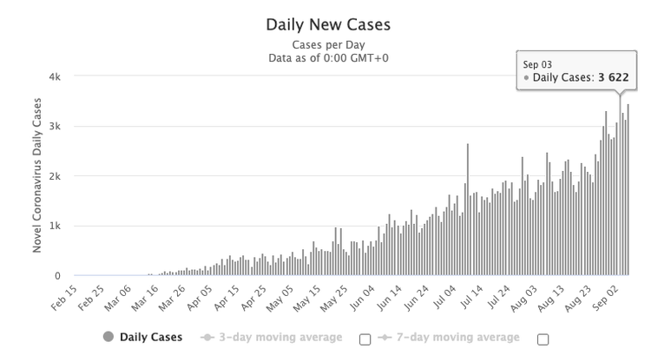
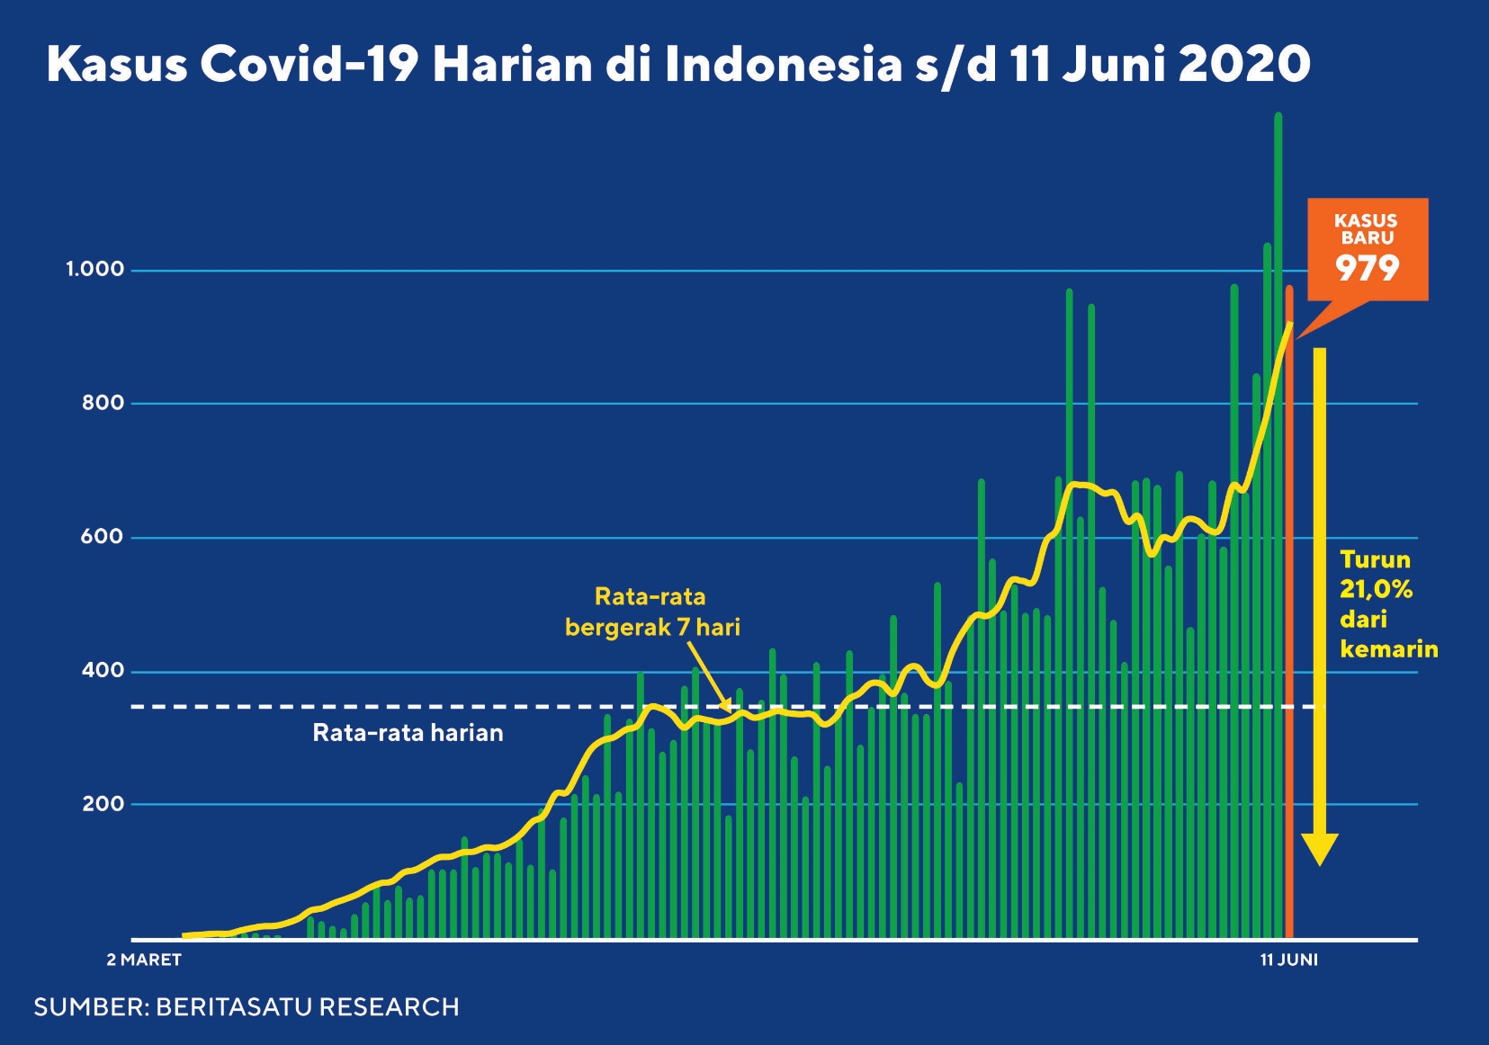
Covid 19 Timeline
WFH HR Policies
Kaizen Ways of Working
Infrastructure Readiness
Jakarta Flood as initial stress test
Work From Home
Januari
Notes:
This is the timeline of how we manage to ride the wave of Covid
WFH policies have been introduced in Indonesia for quite a number of years..
Last year we also introduced Kaizen which also helps in terms of improving way of working on a daily basis not just for operation but even in the senior management team
In the last Major flood in Jakarta early January, our infrastructure to fully WFH was tested, and we managed to find some areas of improvement which puts us in an advantage when we deal with Pandemi situation.

Slide 3
1
Employee Engagement & Wellness
2
Non-Face to Face solution
3
New Sales Model
4
5
Distributor Technology
Customer Technology
Notes:
We also put certain priorities in Manulife Indonesia on how we manage the business or our people during early months of the lock down period.

Slide 4
Prior to BPJS, there were minimum exposure of insurance products to the middle class and mass market
BPJS helps to accelerate the insurance literacy of Indonesian especially in health insurance
Affluent
9% - 24 mio
223 mio
BPJS members
Middle Class
19% - 52 mio
35.14 mio Individual members (peserta mandiri); split into 3 class
55.2 mio of Mandatory BPJS for employees paid by employers
132.6 mio mass market subsidies by government at 4th class (subsidy class)
Prior to the introduction of BPJS, most Indonesian are not familiar with insurance.
BPJS have helped to introduce the concept of Insurance to a much broader customers.
Mass Market
72% - 191 mio
Financial literacy
66% of population are unbanked
Insurance Penetration
Notes:
Why do we need to get insurance to the mass market?
Uninsured people in emerging markets are often only one or two disasters away from slipping back into poverty. Insurance acts as a safety net to stop that from happening. But when we talk about financial inclusion, it’s easier to discuss credit and savings. Insurance is the ugly duckling; it’s the hardest one to get your head around.
Most of the Middle and Mass market segment are still untapped due to the hurdle of exposure prior to BPJS

Slide 5
BPJS helps to accelerate the insurance literacy of Indonesian especially in health insurance
Previously concept of insurance need to be introduced and explained by an insurance agent by having face to face meetings
Notes:
Traditionally Insurance focus on product and pricing to ensure that people don’t defraud them
Insurance love complexity, but for a developing country like Indonesia, most insurance companies have been going through a digital transformation where the key for inclusion is focusing on the distribution question. How can we get our insurance policies to the middle and mass market cheaply and efficiently.

Slide 6
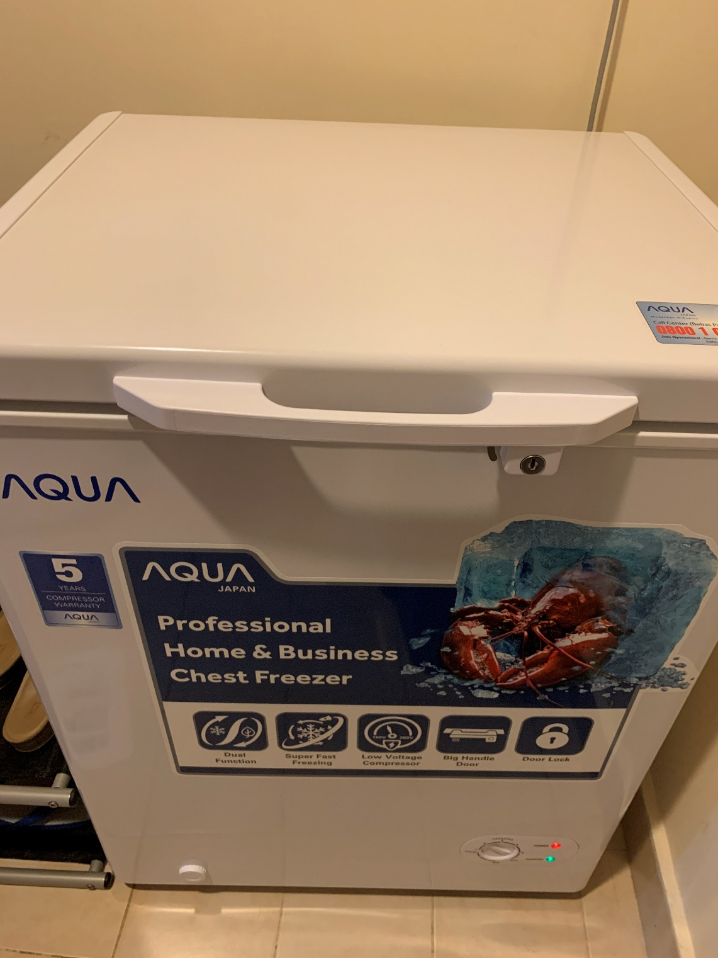
My first experience in online purchase in Indonesia

Slide 7
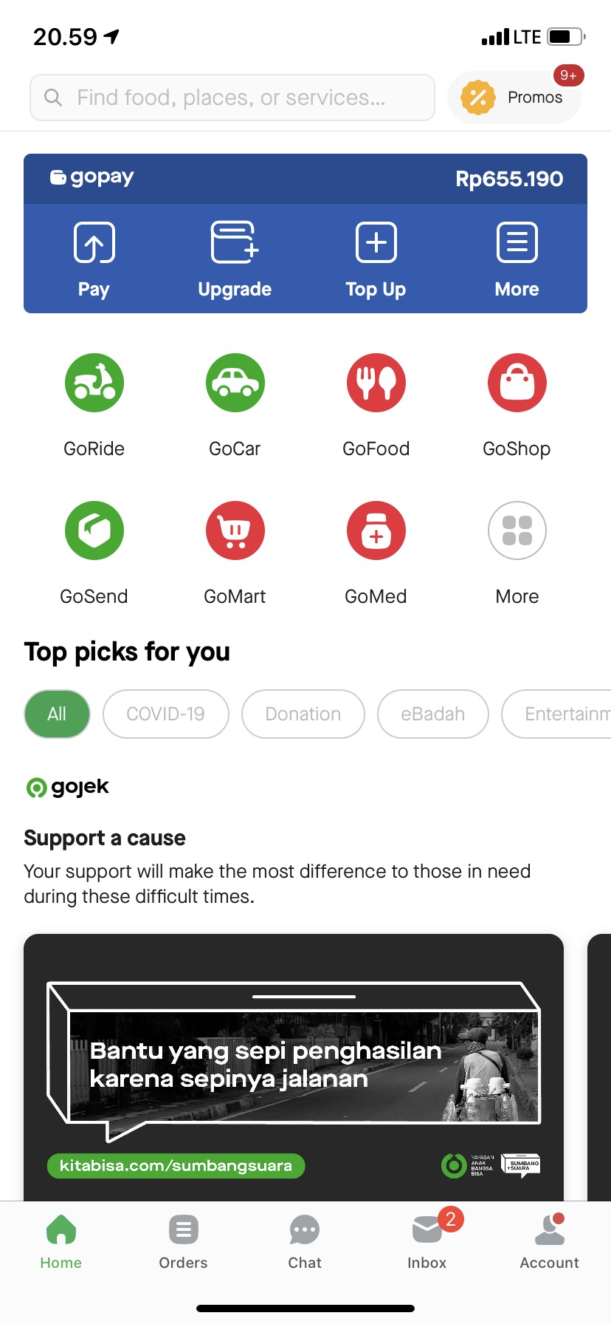
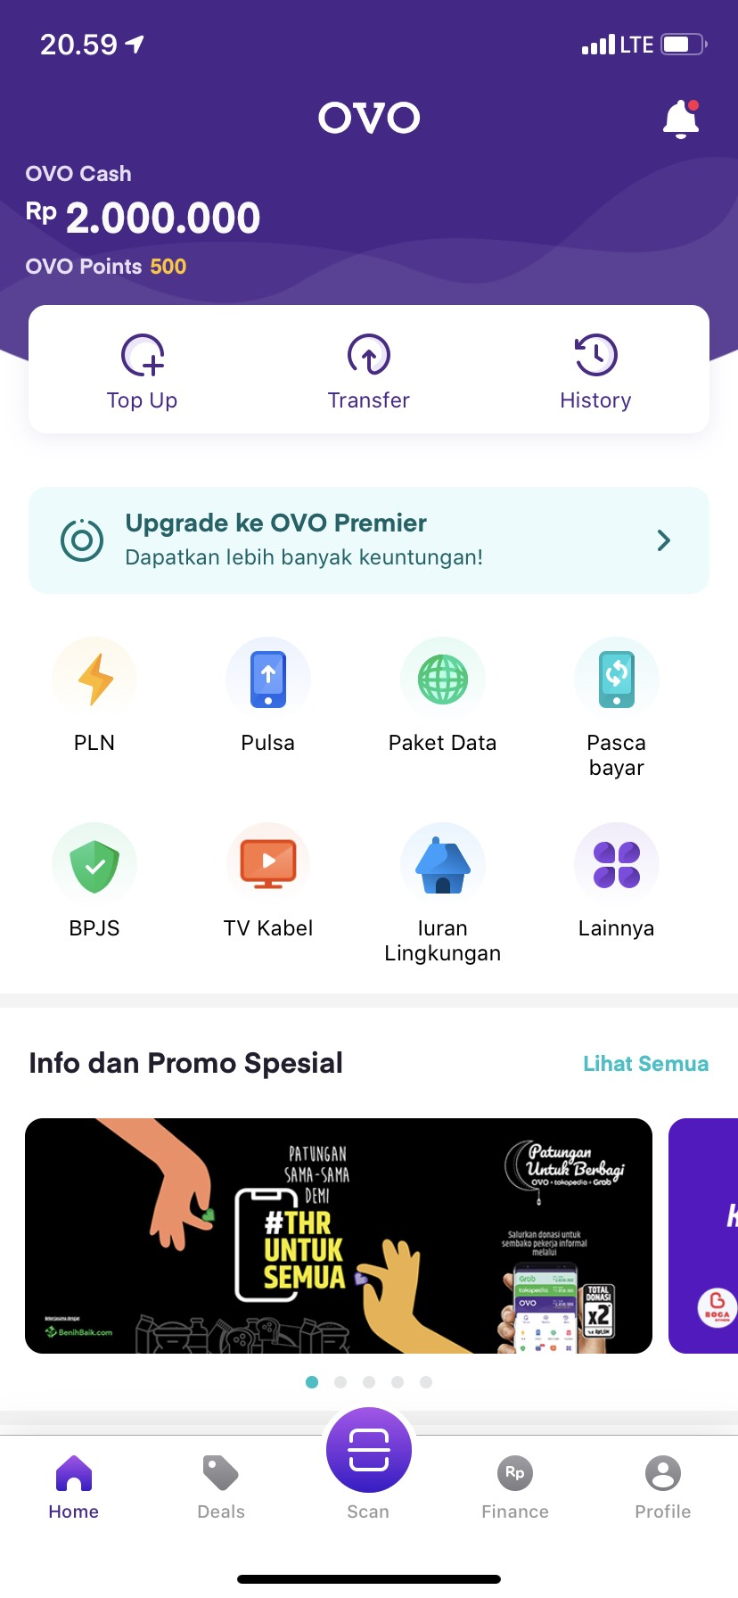
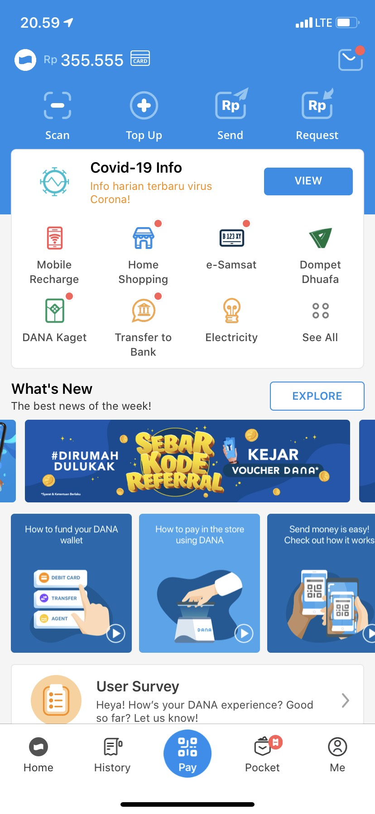

Slide 8
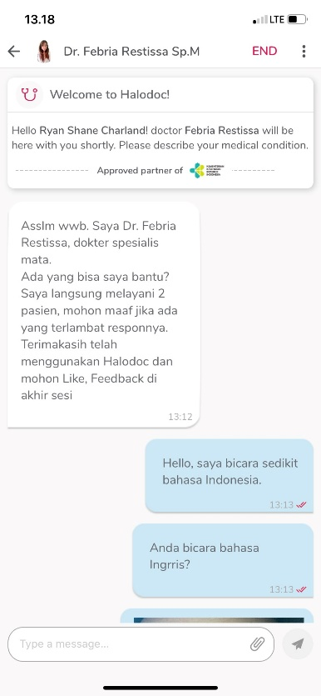
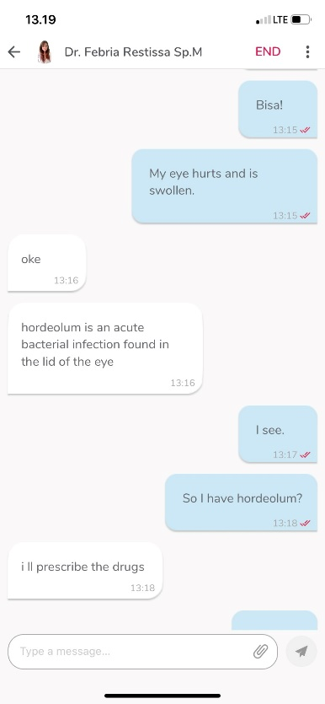
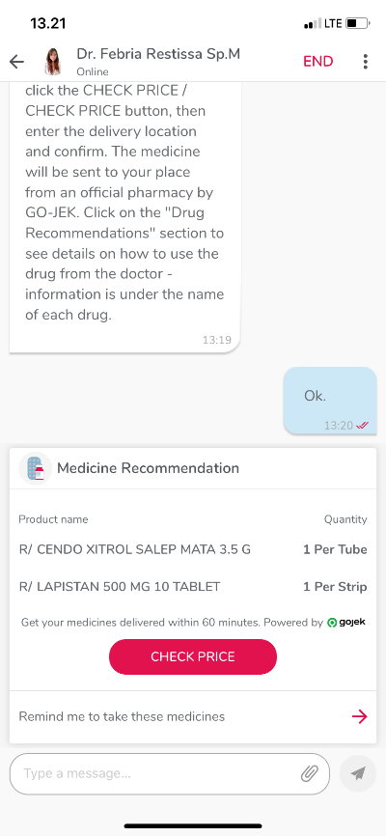
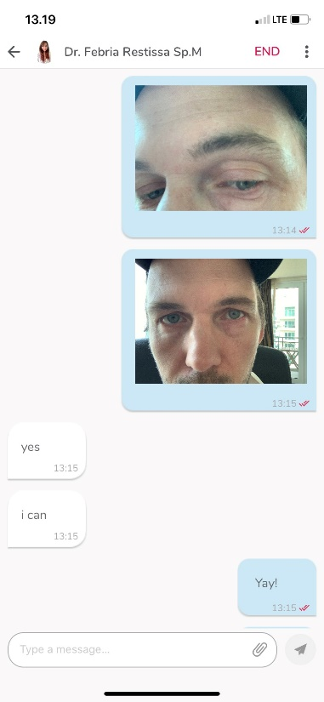
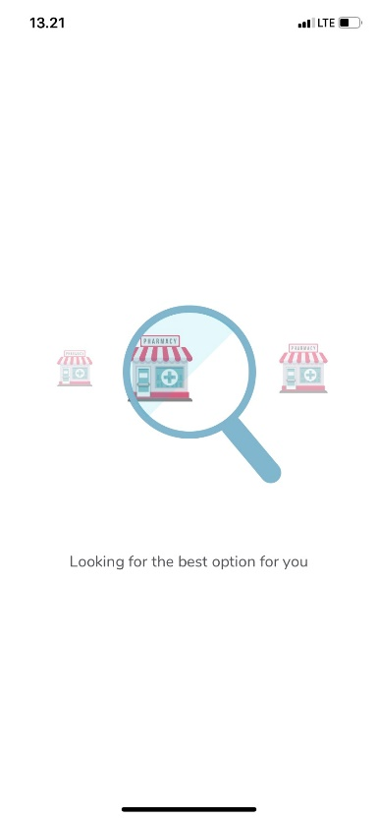
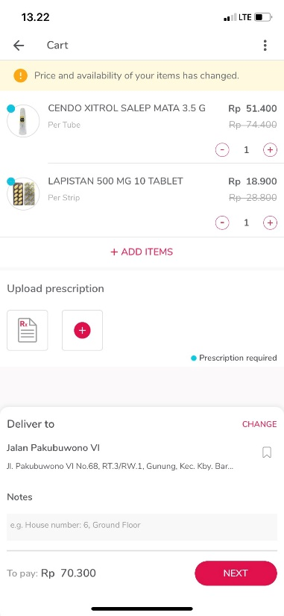
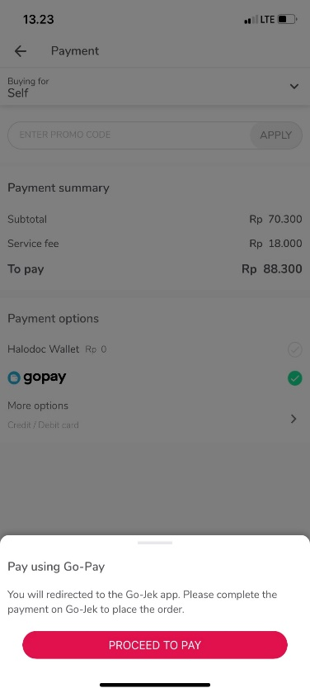
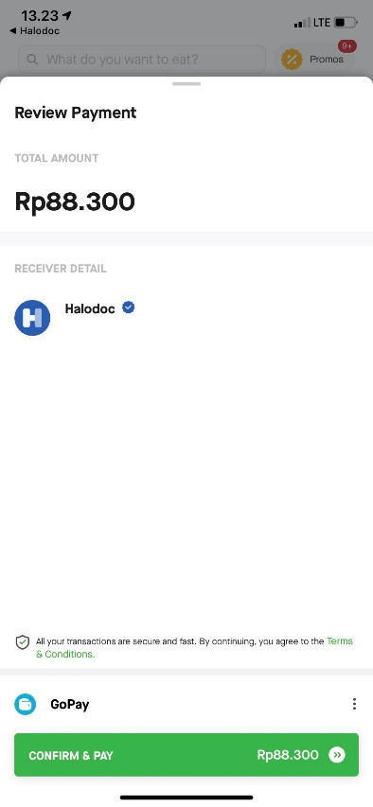
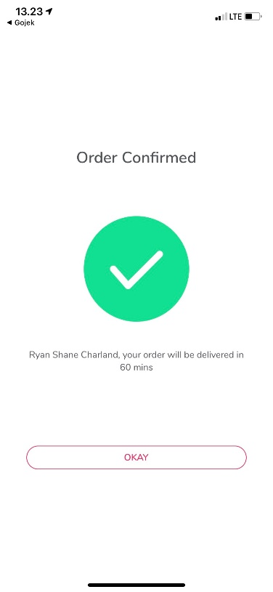
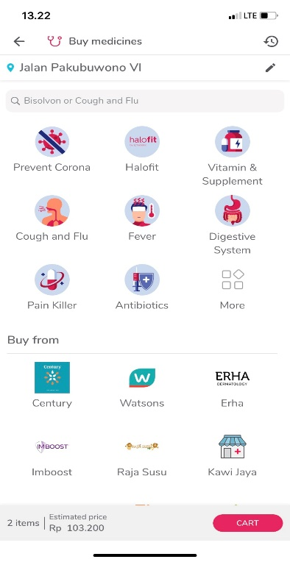
Experiencing Digital Doctor consultation including drug purchase and delivery

Slide 9
Simple and easy to understand
Insurance products
Notes:
When we provide an easy to understand and use product into the customers’ hands by creating a frictionless digital customer journey, customers will appreciate the product, use it and tell their friends with they have gone through a seamless claim process

Slide 10
Notes:
In Manulife, we have worked with our bancassurance partners to successfully offer a simple, low ticket insurance products. Which we need to continue to take to the next level by being sold and serviced digitally in our potential partners whether telco providers, banks, microfinance institutions or eCommerce sites.
Term Life ROP
Monthly allowance for 5 years for 10x monthly premium or lump sum of 500x monthly allowance
Premium as low as 50 K – 2 Mio / month
100% Return on Premium as a no claim bonus
No medical check up required for up to IDR 1 Bio
Hospital cash plan allowance for inpatient customer
Premium as low as 90 K / month
105% Return of Premium paid as a no claim bonus
Hospitalization benefits of starting from 100 K up to 1.5 mio daily
Death cover from 50 mio up to 750 mio

Slide 11
Happy Customers
#ManulifeEverydaybetter
#JadiAndalan
Notes:
A simple proposition whether through text message / Whatsapp message. A simple monthly payment that gets customer that when they go to hospital, we will give them a lumpsum amount of valid claim within few days of admission. The customer can use it to pay for medical cost, loss of earnings or other related expenses. In Indonesia, most people don’t have savings account to fall back on, so this type of proposition would be attractive to most customers.
What are the benefit for the whole industry? The more customers are buying the simple product, insurance companies will be looking at managing a more stable and predictable portfolio and claim experience

